Slide 1
Hierarchical Clustering better than Average Linkage
Recent Results in Hierarchical Clustering
Approximation Bounds for Hierarchical Clustering:
Average Linkage, Bisecting K-means, and Local
Search
Moses Charikar,
Vaggos Chatziafratis,
Rad Niazadeh
Ben Moseley,
Joshua Wang
Disclaimer: All wonderful pictures from their papers / slides.

Slide 2
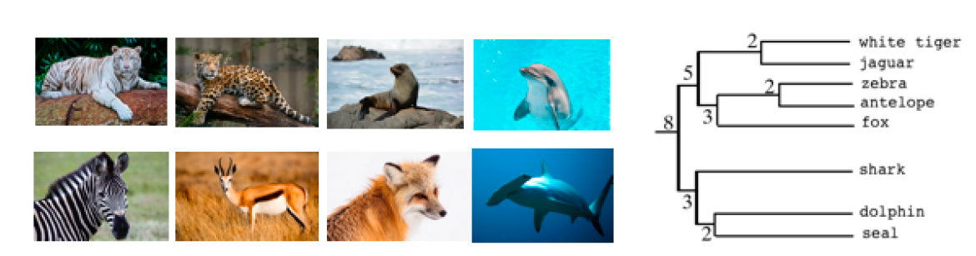
Hierarchical Clustering

Slide 3
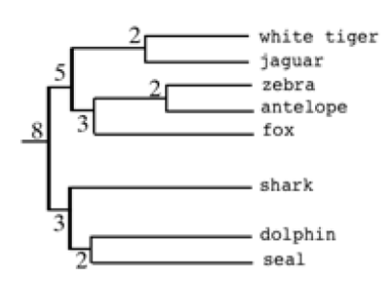
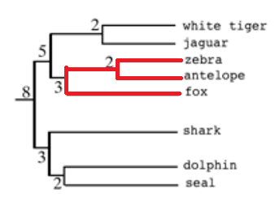
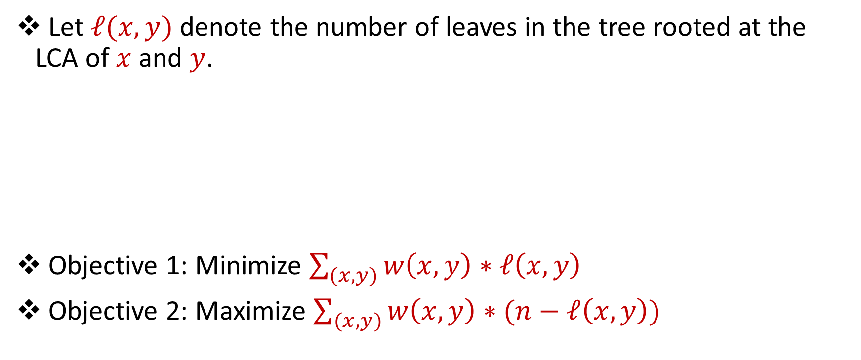
Hierarchical Clustering
Let $ℓ(x,y)$ denote the number of leaves in the tree rooted at the LCA of $x$ and $y$.
Objective 1: Minimize $\sum_{(x,y)}{w\left(x,y\right)∗ℓ\left(x,y\right)}$
Objective 2: Maximize $\sum_{(x,y)}{w\left(x,y\right)∗(n−ℓ\left(x,y\right))}$

Slide 4

Hierarchical Clustering
Maximize $\sum_{(x,y)}{w\left(x,y\right)∗(n−ℓ\left(x,y\right))}$
Rule: Two animals score 1 if they both live on land, or both live in water
(white tiger, jaguar) -> 6
(white tiger, zebra) -> 3
(white tiger, antelope) -> 3
(white tiger, fox) -> 3
(white tiger, shark) -> 0
(zebra, antelope) -> 6
(zebra, fox) -> 5

Slide 5
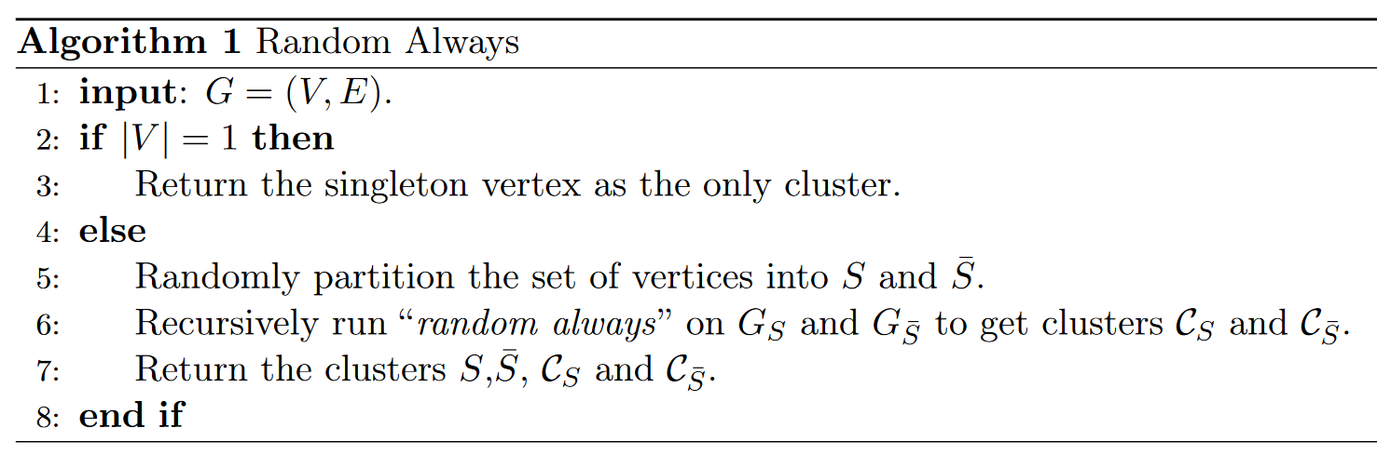
Random Clustering
Recursively cut each cluster randomly until only singletons remain

Slide 6
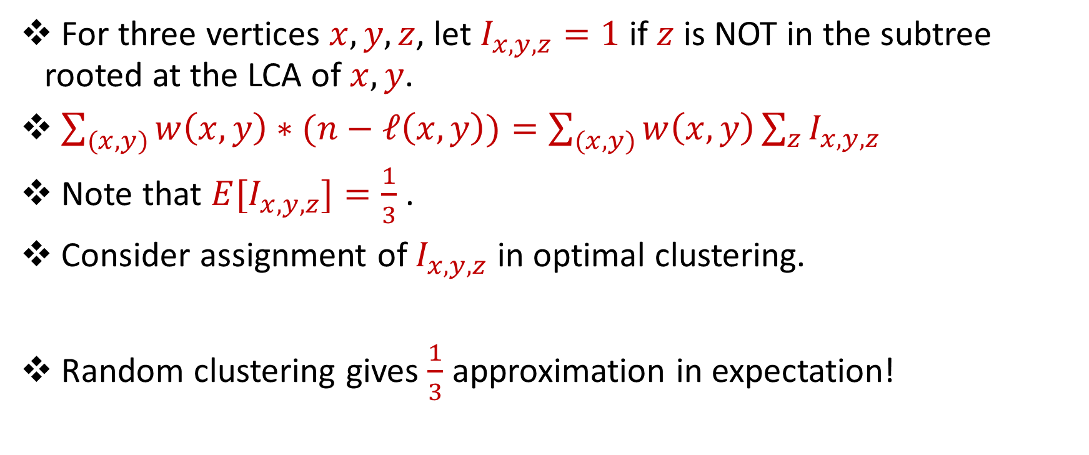
Random Clustering
For three vertices $x,y,z$, let $I_{x,y,z}=1$ if $z$ is NOT in the subtree rooted at the LCA of $x,y$.
$\sum_{(x,y)}{w\left(x,y\right)∗(n−ℓ\left(x,y\right))}=\sum_{(x,y)}{w\left(x,y\right)\sum_{z}{I_{x,y,z}}}$
Note that ${E[I}_{x,y,z}]=\frac{1}{3}$ .
Consider assignment of $I_{x,y,z}$ in optimal clustering.
Random clustering gives $\frac{1}{3}$ approximation in expectation!

Slide 7
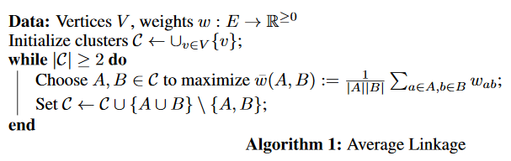

Average Linkage
Let $\overline{w}\left(a,b\right)=\frac{1}{\left|A\right||B|}$ $\sum_{a∈A,b∈B}{w\left(a,b\right)}$ be the average similarity between clusters $A$ and $B$.
Repeatedly merge clusters with $A$ and $B$highest average similarity $\overline{w}\left(a,b\right)$.

Slide 8
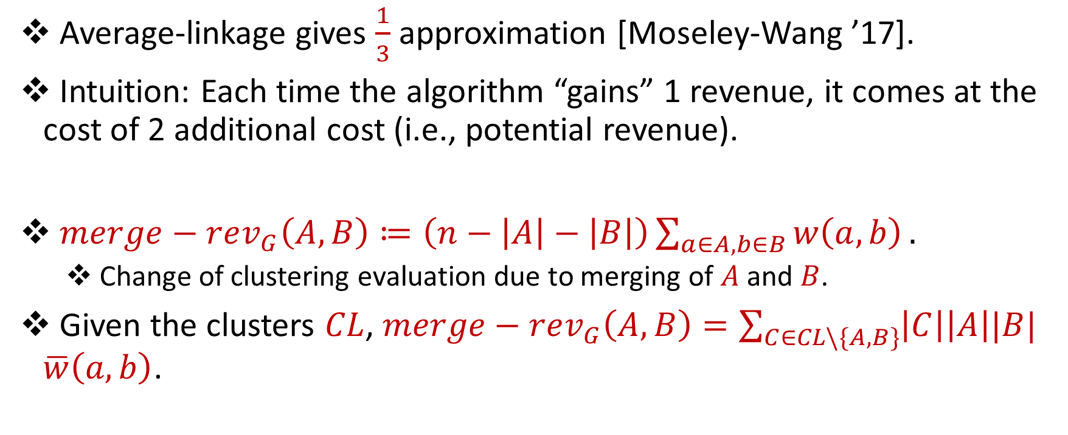
Average Linkage Approximation
Average-linkage gives $\frac{1}{3}$ approximation [Moseley-Wang ’17].
Intuition: Each time the algorithm “gains” 1 revenue, it comes at the cost of 2 additional cost (i.e., potential revenue).
$merge−rev_{G}\left(A,B\right)≔\left(n−\left|A\right|−\left|B\right|\right)\sum_{a∈A,b∈B}{w\left(a,b\right)}.$
Change of clustering evaluation due to merging of $A$ and $B$.
Given the clusters $CL$, $merge−rev_{G}\left(A,B\right)=\sum_{C∈CL\backslash \{A,B\}}{\left|C\right|\left|A\right||B|}$ $\overline{w}\left(a,b\right)$.

Slide 9
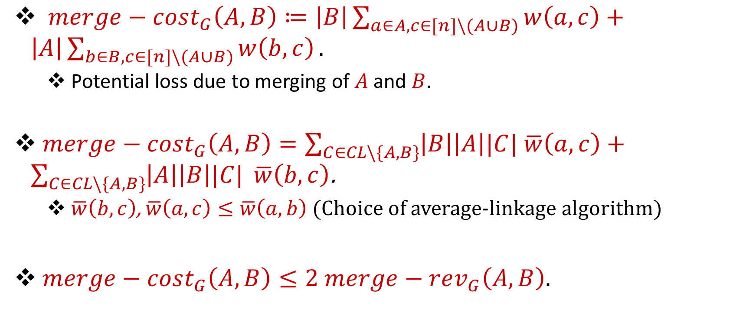
Average Linkage Approximation
$merge−cost_{G}\left(A,B\right)≔\left|B\right|\sum_{a∈A,c∈[n]\backslash (A∪B)}{w\left(a,c\right)}+\left|A\right|\sum_{b∈B,c∈[n]\backslash (A∪B)}{w\left(b,c\right)}.$
Potential loss due to merging of $A$ and $B$.
$merge−cost_{G}\left(A,B\right)=\sum_{C∈CL\backslash \{A,B\}}{\left|B\right|\left|A\right||C|}$ $\overline{w}\left(a,c\right)+\sum_{C∈CL\backslash \{A,B\}}{\left|A\right|\left|B\right||C|} \overline{w}\left(b,c\right)$.
$\overline{w}\left(b,c\right)$, $\overline{w}\left(a,c\right)≤\overline{w}\left(a,b\right)$(Choice of average-linkage algorithm)
$merge−cost_{G}\left(A,B\right)≤2$ $merge−rev_{G}\left(A,B\right).$

Slide 10
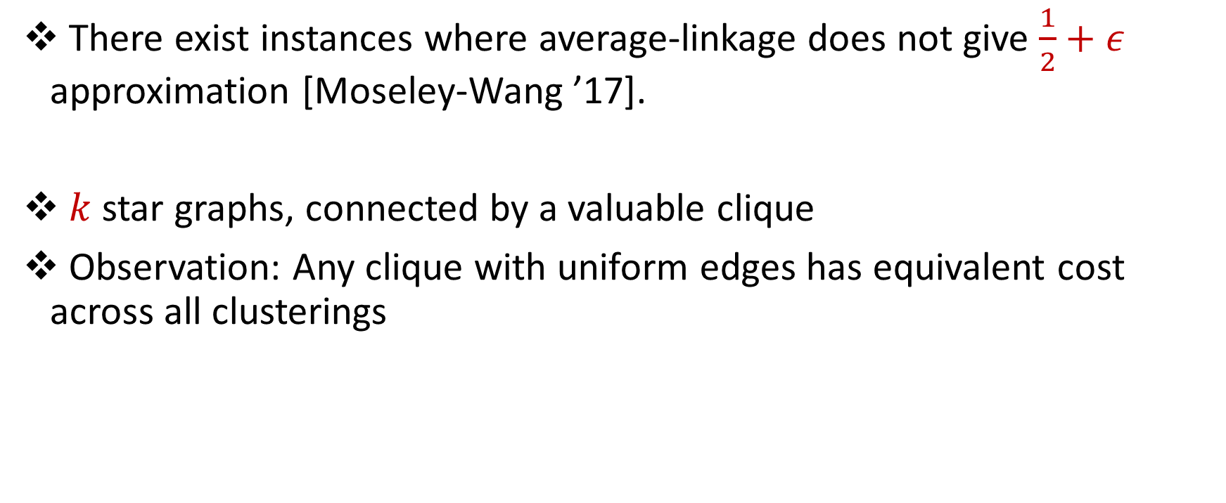
Average Linkage Worst Case (Part 1)
There exist instances where average-linkage does not give $\frac{1}{2}+ε$ approximation [Moseley-Wang ’17].
$k$star graphs, connected by a valuable clique
Observation: Any clique with uniform edges has equivalent cost across all clusterings

Slide 11
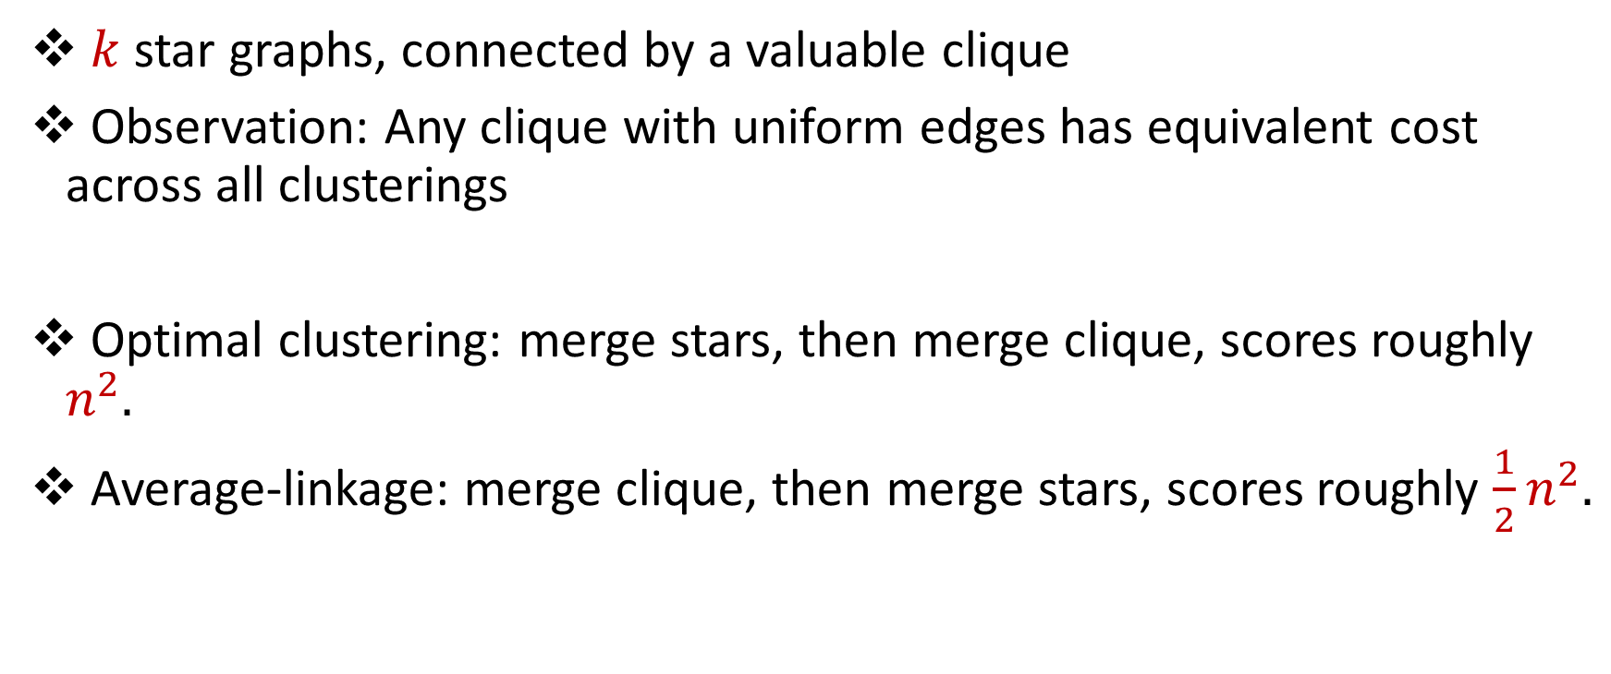
Average Linkage Worst Case (Part 1)
$k$star graphs, connected by a valuable clique
Observation: Any clique with uniform edges has equivalent cost across all clusterings
Optimal clustering: merge stars, then merge clique, scores roughly $n^{2}.$
Average-linkage: merge clique, then merge stars, scores roughly $\frac{1}{2}n^{2}.$

Slide 12
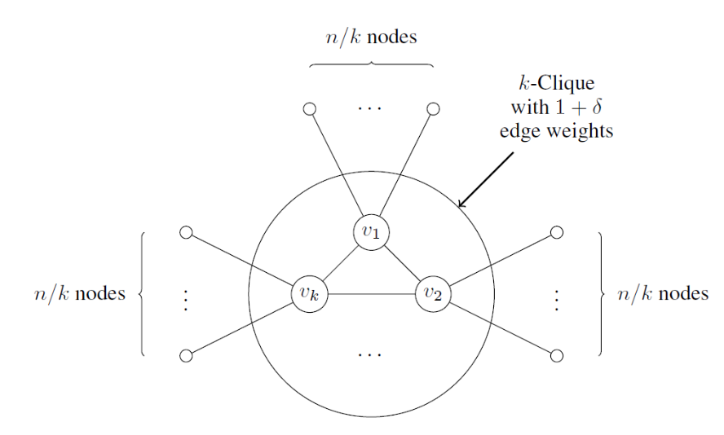
Average Linkage Worst Case (Part 1)

Slide 13
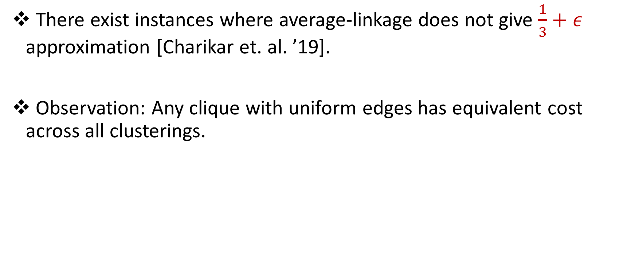
Average Linkage Worst Case (Part 2)
There exist instances where average-linkage does not give $\frac{1}{3}+ε$ approximation [Charikar et. al. ’19].
Observation: Any clique with uniform edges has equivalent cost across all clusterings.

Slide 14
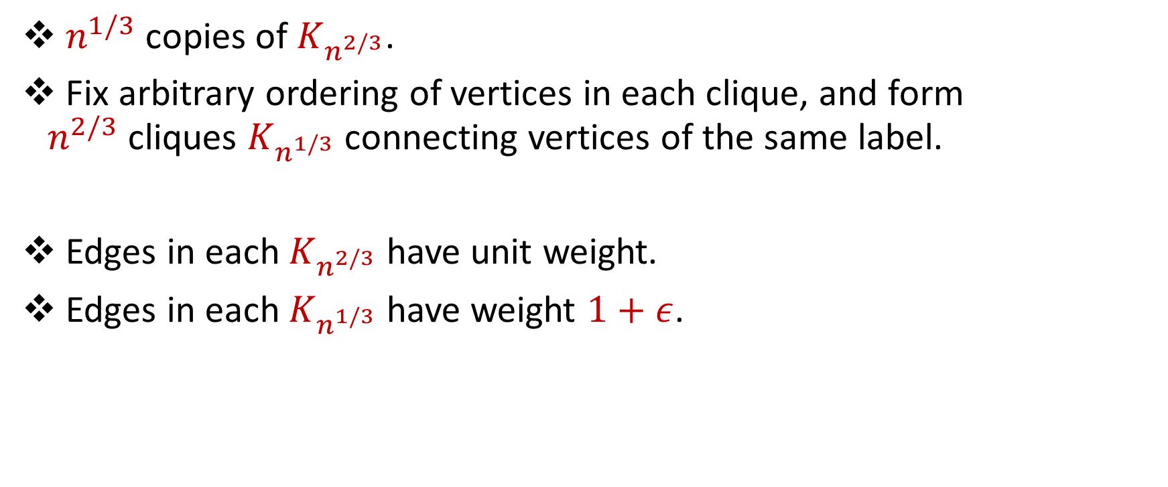
Average Linkage Worst Case (Part 2)
$n^{1/3}$ copies of $K_{n^{2/3}}$.
Fix arbitrary ordering of vertices in each clique, and form $n^{2/3}$cliques $K_{n^{1/3}}$ connecting vertices of the same label.
Edges in each $K_{n^{2/3}}$ have unit weight.
Edges in each $K_{n^{1/3}}$ have weight $1+ε$.

Slide 15
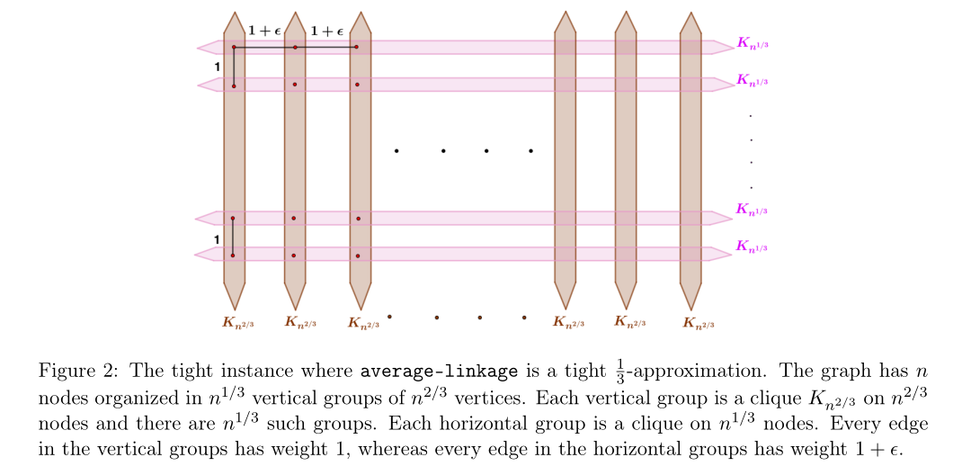
Average Linkage Worst Case (Part 2)

Slide 16
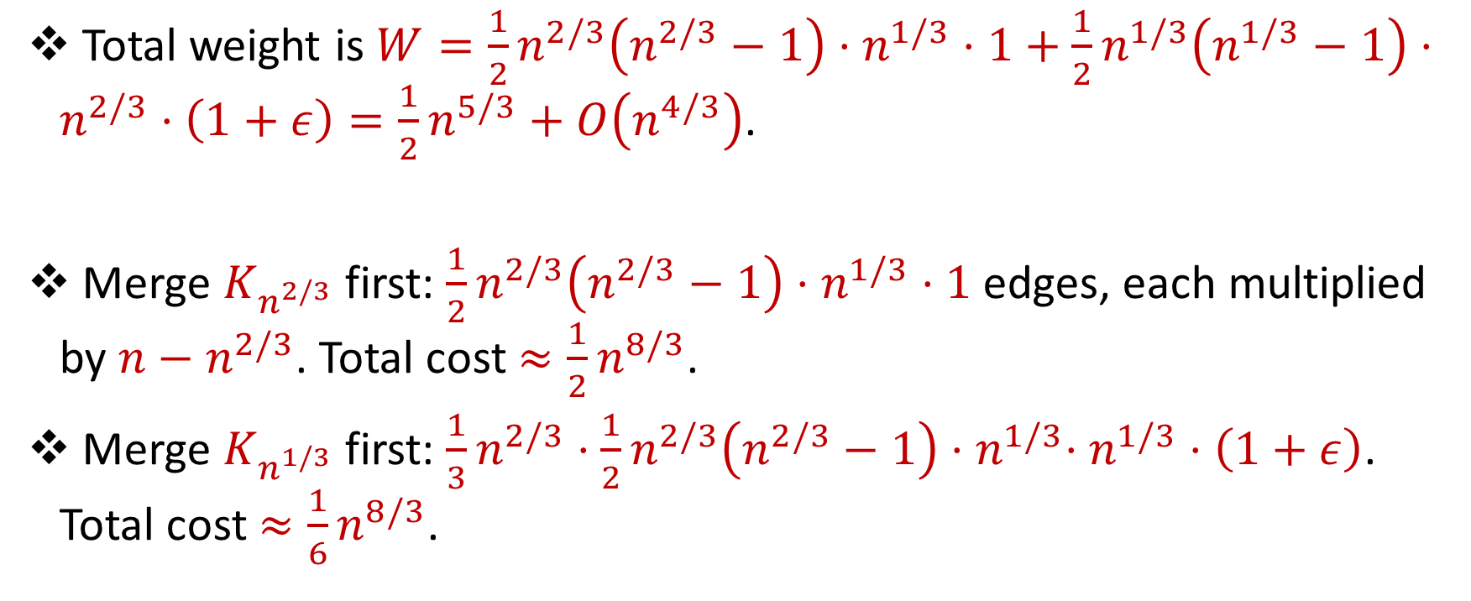
Average Linkage Worst Case (Part 2)
Total weight is$W={\frac{1}{2}n}^{2/3}\left(n^{2/3}−1\right)⋅n^{1/3}⋅1+{\frac{1}{2}n}^{1/3}\left(n^{1/3}−1\right)⋅n^{2/3}⋅\left(1+ε\right)=\frac{1}{2}n^{5/3}+O\left(n^{4/3}\right)$.
Merge $K_{n^{2/3}}$ first: ${\frac{1}{2}n}^{2/3}\left(n^{2/3}−1\right)⋅n^{1/3}⋅1$ edges, each multiplied by ${n−n}^{2/3}$. Total cost ${≈\frac{1}{2}n}^{8/3}$.
Merge $K_{n^{1/3}}$ first: ${\frac{1}{3}n}^{2/3}⋅{\frac{1}{2}n}^{2/3}\left(n^{2/3}−1\right){⋅n}^{1/3}⋅n^{1/3}⋅\left(1+ε\right)$. Total cost ${≈\frac{1}{6}n}^{8/3}$.

Slide 17
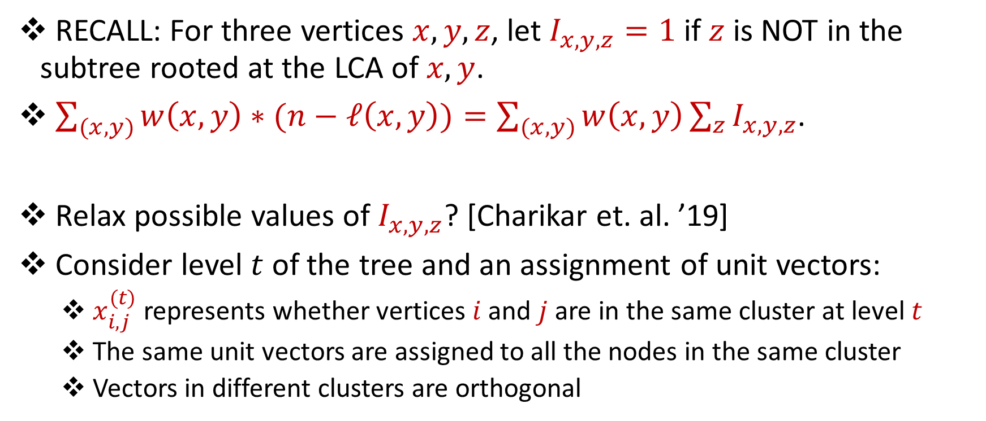
Beating Average Linkage
RECALL: For three vertices $x,y,z$, let $I_{x,y,z}=1$ if $z$ is NOT in the subtree rooted at the LCA of $x,y$.
$\sum_{(x,y)}{w\left(x,y\right)∗(n−ℓ\left(x,y\right))}=\sum_{(x,y)}{w\left(x,y\right)\sum_{z}{I_{x,y,z}}}$.
Relax possible values of $I_{x,y,z}$? [Charikar et. al. ’19]
Consider level $t$ of the tree and an assignment of unit vectors:
$x_{i,j}^{(t)}$ represents whether vertices $i$ and $j$ are in the same cluster at level $t$
The same unit vectors are assigned to all the nodes in the same cluster
Vectors in different clusters are orthogonal

Slide 18
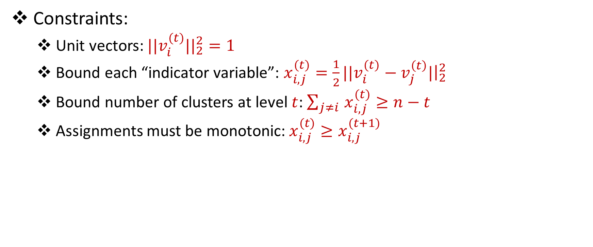
Beating Average Linkage
Constraints:
Unit vectors: ${||v_{i}^{(t)}||}_{2}^{2}=1$
Bound each “indicator variable”: ${x_{i,j}^{(t)}=\frac{1}{2}||v}_{i}^{(t)}−v_{j}^{\left(t\right)}|{\left.​\right|}_{2}^{2}$
Bound number of clusters at level $t$: $\sum_{j≠i }{x_{i,j}^{(t)}≥n−t}$
Assignments must be monotonic:$x_{i,j}^{(t)}≥x_{i,j}^{(t+1)}$

Slide 19
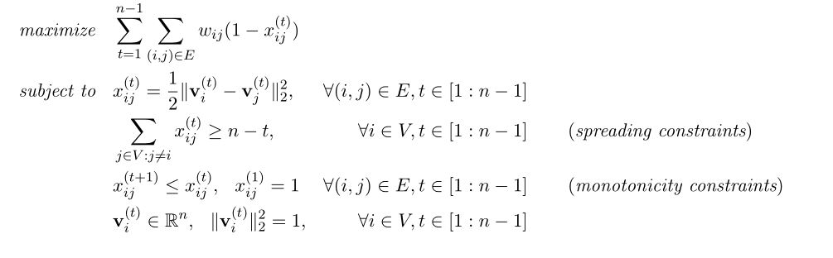
Beating Average Linkage

Slide 20
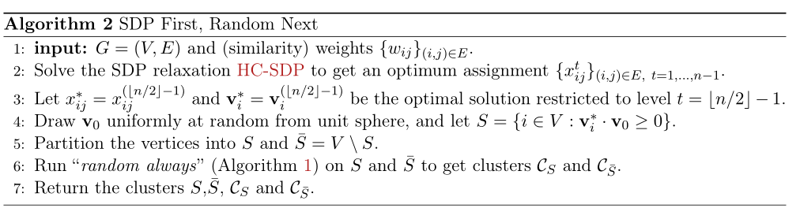
Beating Average Linkage
Solve the SDP and round vertices to obtain first cut
Randomly partition afterwards -> 0.336379-approximation [Charikar et. al. ’19].

Slide 21

Future Work?
Low dimension data
Specific similarity functions
Hardness of approximation
Other objectives (e.g., dissimilarity [Cohen-Addad et. al. ’18])

